Slide 1



Statisense
View in Power BI
Last data refresh:
7/31/2025 4:49:03 PM UTC
Downloaded at:
7/31/2025 4:57:32 PM UTC

Slide 2
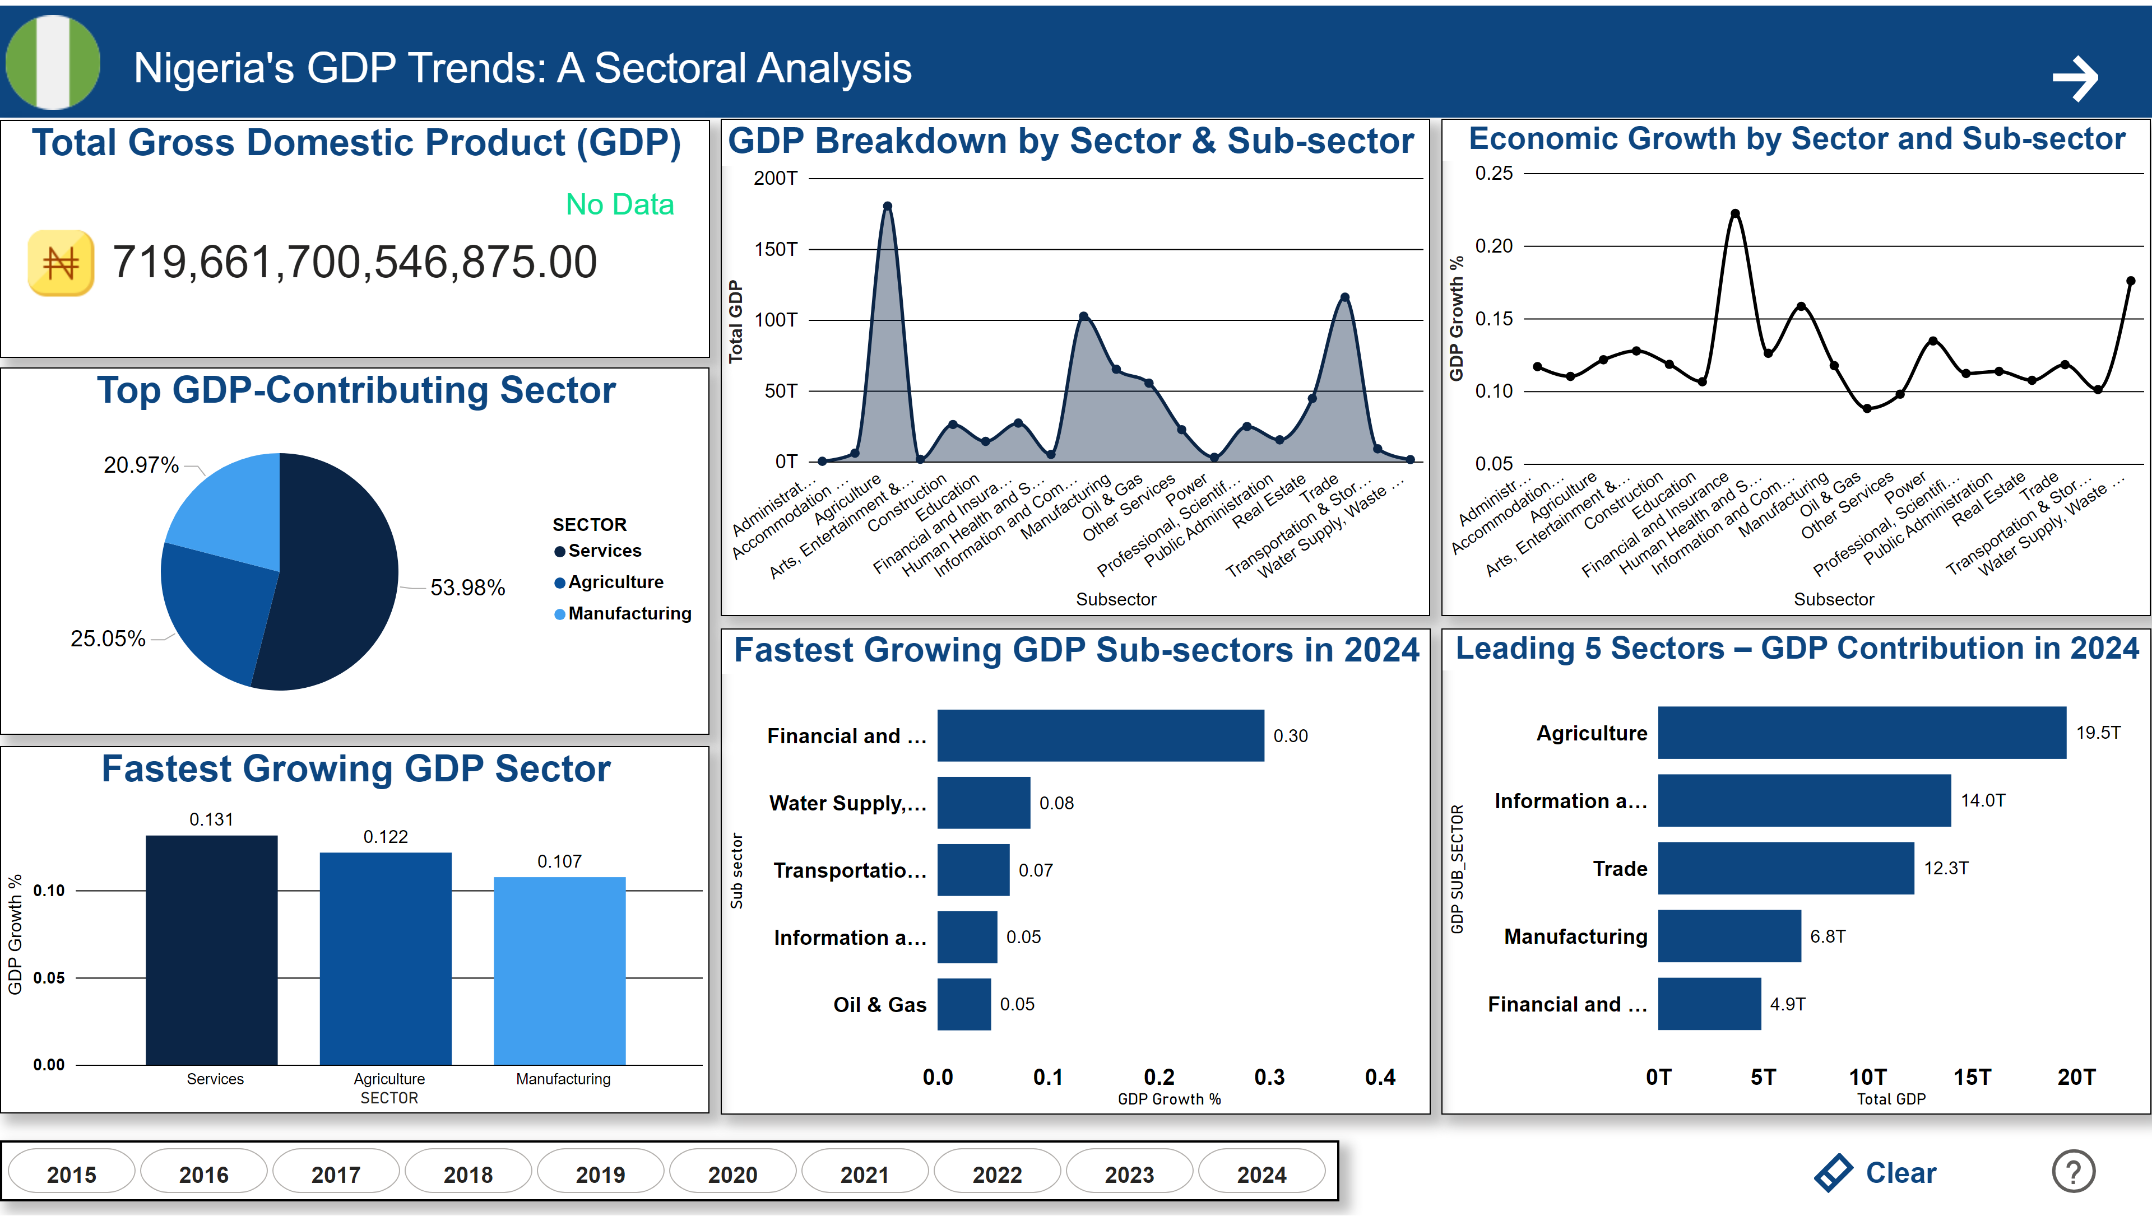
GDP
Notes:
image
No alt text provided
textbox
No alt text provided
advancedSlicerVisual
No alt text provided
actionButton
No alt text provided
actionButton
No alt text provided
Total Gross Domestic Product (GDP)
No alt text provided
image
No alt text provided
card
No alt text provided
Top GDP-Contributing Sector
No alt text provided
Fastest Growing GDP Sector
No alt text provided
GDP Breakdown by Sector & Sub-sector
No alt text provided
Economic Growth by Sector and Sub-sector
No alt text provided
Fastest Growing GDP Sub-sectors in 2024
No alt text provided
Leading 5 Sectors – GDP Contribution in 2024
No alt text provided
image
No alt text provided
actionButton
No alt text provided

Slide 3
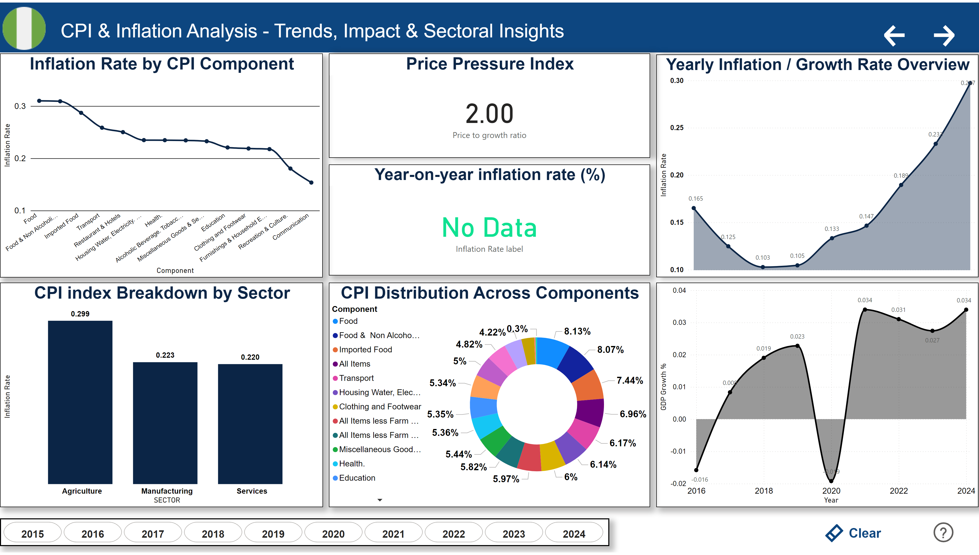
CPI
Notes:
image
No alt text provided
textbox
No alt text provided
advancedSlicerVisual
No alt text provided
actionButton
No alt text provided
actionButton
No alt text provided
image
No alt text provided
actionButton
No alt text provided
actionButton
No alt text provided
Inflation Rate by CPI Component
No alt text provided
Yearly Inflation / Growth Rate Overview
No alt text provided
areaChart
No alt text provided
CPI index Breakdown by Sector
No alt text provided
CPI Distribution Across Components
No alt text provided
Price Pressure Index
No alt text provided
Year-on-year inflation rate (%)
No alt text provided
image
No alt text provided

Slide 4
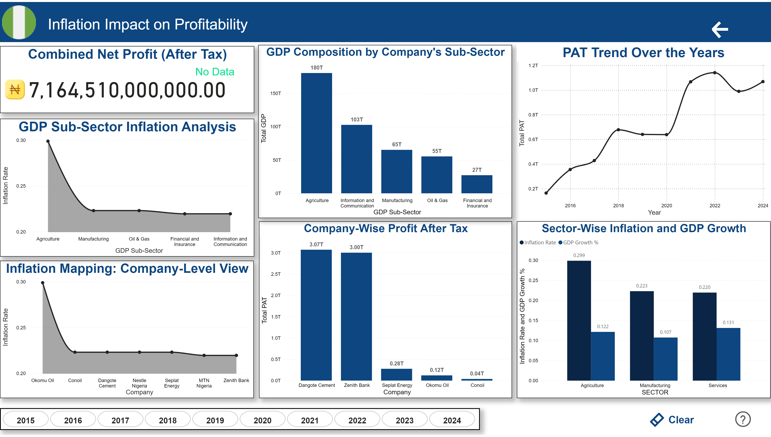
PAT
Notes:
image
No alt text provided
textbox
No alt text provided
advancedSlicerVisual
No alt text provided
actionButton
No alt text provided
actionButton
No alt text provided
image
No alt text provided
actionButton
No alt text provided
image
No alt text provided
Sector-Wise Inflation and GDP Growth
No alt text provided
Inflation Mapping: Company-Level View
No alt text provided
GDP Sub-Sector Inflation Analysis
No alt text provided
Company-Wise Profit After Tax
No alt text provided
GDP Composition by Company's Sub-Sector
No alt text provided
PAT Trend Over the Years
No alt text provided
Combined Net Profit (After Tax)
No alt text provided
image
No alt text provided
card
No alt text provided
image
No alt text provided

